Slide 1
SENTIMENT ANALYSIS OF COVID-19 TWEETS
TEAM NAME: A2M
APPLICATION ID: SPS_CH_APL_2020000903
PROJECT ID: SPS_PRO_1525
NAME:
Aastha Singh
Megha Gupta
Akshita Agarwal

Slide 2
Problem Statement
The sentiment analysis of people since the lockdown enforcement using relevant #tags and build a model to understand the behavior of people if the lockdown is further extended. Also develop a dashboard with visualization of people reaction to the govt announcements on lockdown extension.

Slide 3
Proposed Solution
Our solution approach includes using the past tweets as training dataset and using them to make a BERT model to help predict the emotions of the tweets taken as input in the model. We have also used the data of news using MALLET which helps in analysis the “hot topics” in the public during the pandemic. Both these informations are presented in pictorial form using DASH. These pictorial representations can be very helpful in predicting the reaction of public on further decisions which can be taken by government.
Technology used:
Basic coding language- Python
Textblob and IBM Watson Tone Analyzer- creating training dataset.
BERT- Classifying in 5 emotions.
MALLET- Analysis of news
DASH- for visualization

Slide 4
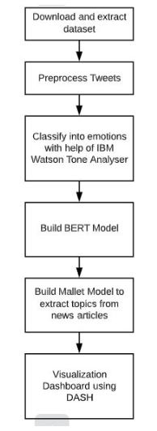
Flowchart
Proposed solution flow:

Slide 5
Dataset :Extraction and Preprocessing
The main data set of complete tweets has been taken from IEEE website. It includes tweets from 21 March till 31 May
Hydrator is used to extract tweets from and their details from their tweet ids.
The obtained tweets from the hydrator is then preprocessed which includes cleaning the tweets and remove unwanted characters and spaces.
The main python libraries which we have used for preprocessing are pandas, numpy, string, nltk.

Slide 6
Textblob Analysis
The preprocessed tweets are then taken as an input to the textblob model for sentiment analysis.
Textblob gives the Subjectivity and the polarity of the tweets in question as float values. Subjectivity values nearer to 0 indicated less descriptive and that nearer to 1 indicates more descriptive tweets. In polarity, if the value is greater than 0 , the tweet is considered ‘Positive’,If lower than 0 , it is considered negative else it is considered neutral.

Slide 7
IBM WATSON TONE ANALYZER
Predicts emotions present in the preprocessed tweets
API returns tones that have a confidence score greater than 0.5
Analysis of tweets done for five emotions:
Anger, Joy, Sadness, Fear and Analytical
Datasets are further used to train BERT Model for further fine tuning

Slide 8
BERT
We used previously obtained labeled dataset as out training set for the Google BERT model, a state-of-art machine learning technique for classification. Choosing BERT over other model gave as an advantage of training a model with a limited training set and also yielded high accuracy.
We utilised the pre-trained BERT bert-base-uncsed’ model(which contains 12-layer, 768-hidden, 12-heads, 110M parameters), add an untrained layer of neurons on the end, and train the new model for our classification task.

Slide 9
Following are the steps followed to train the Model:
Tokenization and Input Formation, It includes :
Bert tokenizer
Converting Sentences to ids
Padding and Truncating
Adding attention Masks
Training and Validation Split
Converting into PyTorch Data Types
Train our classification Model
BertForSequenceClassification
Optimizer and Learning Rate Scheduler
Training Loop

Slide 10
TOPIC MODELLING USING MALLET
Technique used to extract topics from large volumes of text.
Train a MALLET model to identify keywords from different documents and infer topic composition
Identify topics from news articles related to COVID 19.
Manually identified different topics such as:
Life during covid, Healthcare, Vaccine, USA: Hotspot, Travel Restriction, Lockdown, Effect on Economy.

Slide 11
TOPICS AND KEYWORDS
USA: Hotspot - trump, president, state, administration, white_house, american
Vaccine: virus, drug, human, study, question, spread, give, thing, infect, find
Healthcare: health, week, ventilator, home, work, add, pandemic, call, hospital
Life during Covid: people, time, feel, make, life, social, family, sick, home, face
Travel Restriction: country, china, government, travel, day, restriction, time
Effect on Economy: company, year, market, demand, week, stock, pandemic, economic
Lockdown: people, police, authority, government, lockdown, monday, quarantine

Slide 12
Analysis
Sentiment Analysis of Tweets
We calculated the Average Subjectivity and Polarity of the tweets and saw a trend of tweets becoming more positive and descriptive over the time ( i.e. from March to May). Also, when the data of positive,negative and neutral tweets were analyses, the positive sentiment was found to be on a great rise whereas neutral and negative sentiment dropped and rose a little respectively. Majority (39.9%) of the tweets seem to contain the neutral sentiment.

Slide 13
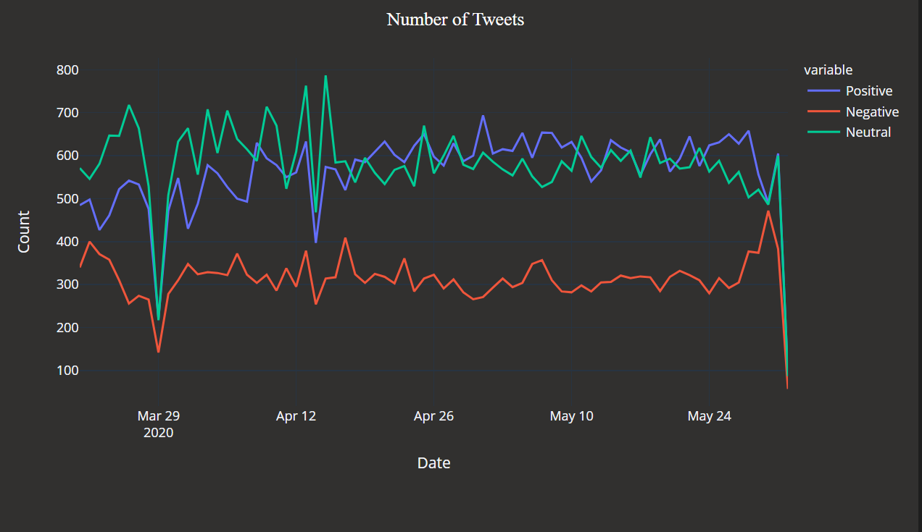
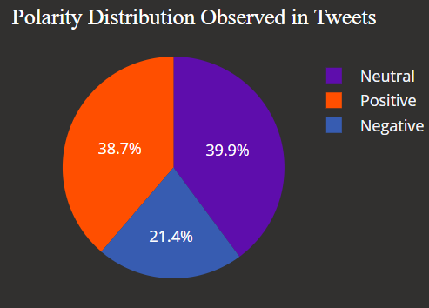

Slide 14
2. Five Emotions Sentiment Analysis
Before the first announcement of lockdown sentiment ‘Joy’ was detected in most of the tweets with ‘Sadness’ and ‘Analytical’ closely competing for second position. However, after the announcement, the sentiment ‘Joy’ in the tweets saw a decline and ‘Analytical’ and ‘Sadness’ were on a rise. Right after the announcement of lockdown, 'Anger’ and ‘Sadness’ saw a sudden rise while ‘Joy’ and ‘Fear’ reduced significantly. Most rise is seen in the sentiment ‘Analytical’. With every subsequent announcement of extension of lockdown, ‘Analytical’ sentiment levels have risen. Interesting trend is observed in ‘Fear’, with the extension of lockdown, the ‘fear’ component started appearing less in the tweets.Though when the lockdown was finally lifted (May 30th) a peak is observed indicating a sudden rise in fear in public. Overloaded with information seems to have made people less sensitive.’Anger’ has shown a significant decline until the end of may. Probably, the news of lockdown being lifted instead of infected cases rising causes a restlessness in the public. ‘Sadness’ is the sentiment which shows a constant increase.

Slide 15
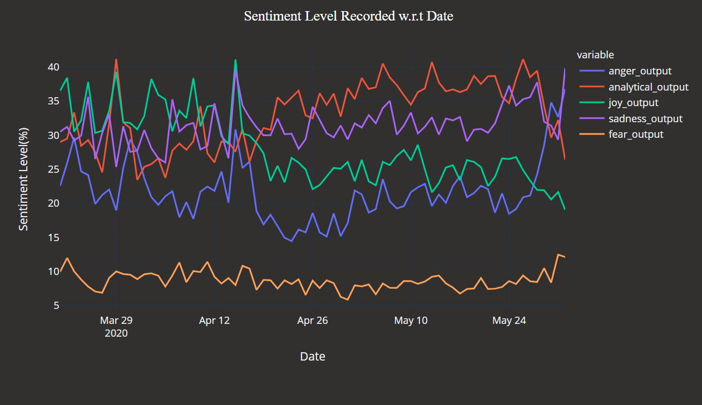
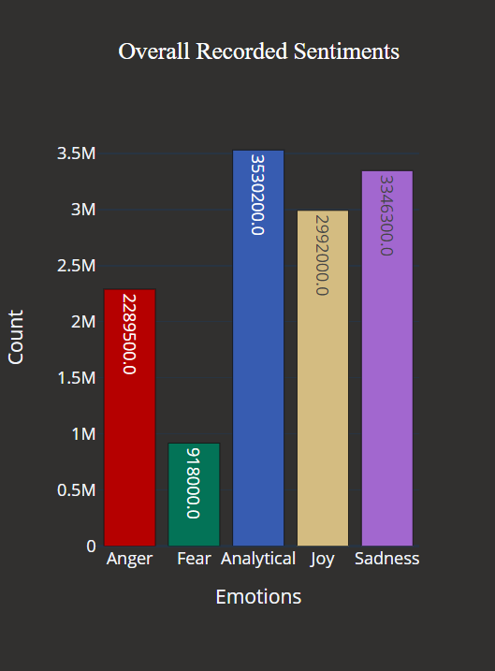

Slide 16
3. Topic Modelling
We utilized Mallet, a natural language processing toolkit, to perform Latent Dirichlet Allocation (LDA) topical modelling, and summarized 7 topics. We named these topics by summarizing the topic keywords returned by the model, and they are as follows (following the descending sequence of frequency): Life during COVID-19, Healthcare, Vaccine, USA: hotspot, Travel Restrictions,Lockdown, Effect on Economy.
For the sentiment of all topics in news, we saw that average polarity is around 0.059 which indicates that on average the news reports contain positive news. Although the news articles on the day after the announcement of lockdown extension are made, show negative polarity denoting ‘Lockdown’ in general is conceived as a ‘negative’ news. Although after the announcement of lockdown 3.0, the polarity is maintained at a positive side.

Slide 17
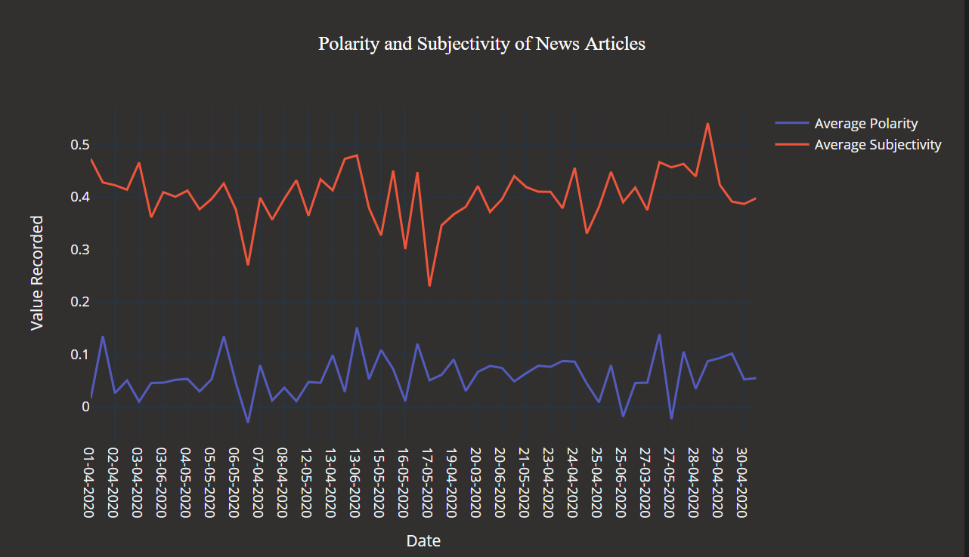
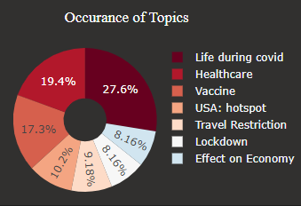

Slide 18
Accuracies and Result:
Following are the accuracies of the Model:
MODEL NAME | ACCURACY
BERT Model For ‘Anger’ | 73.7%
BERT Model For ‘Analytical | 93.1%
BERT Model For ‘Fear’ | 68.9%
BERT Model For ‘Sadness’ | 70.1%
BERT Model For ‘Joy’ | 89.9%

Slide 19
CONCLUSION
With the help of the Sentiment Analysis Dashboard, we are able to:
1. Polarity (positive, neutral and negative) and subjectivity of tweets. 2. Detect tones present in tweets, namely Anger, Fear, Joy, Sadness and Analytical. 3. Analyse the rise and fall of positive, neutral and negative sentiments during the lockdown. 4. Identify major topics of interest during the lockdown.

Slide 20
FUTURE SCOPE OF WORK
Integrate the dashboard with various other functionalities like:
Display number of positive and recovered COVID-19 patients.
Display status of medicines & other government notices.
Mask detection and number of people wearing masks.
Provide an all round analysis of COVID-19 and how it has impacted the world.

Slide 21
THANKYOU
For more information, View our DashBoard hosted on IBM Cloud

